Slide 1
Course Code: CSC211A Course Title: Formal Languages and Automata Theory
Lecture 32: Variations of Turing Machines -1
Course Leader:
Prakash P
prakashp.cs.et@msruas.ac.in

Slide 2
Session Objectives
At the end of this session, student will be able to
Explain the standard model
Describe variations of the standard model
Explain power of classes
Understand turing machines with stay-option
Understand standard machine--multiple track tape
Describe semi-infinite tape
Discuss the off-line machine

Slide 3
Session Topics
The Standard Model
Variations of the Standard Model
Power of Classes
Simulation
Turing Machines with Stay-Option
Standard Machine--Multiple Track Tape
Semi-Infinite Tape
The Off-Line Machine

Slide 4
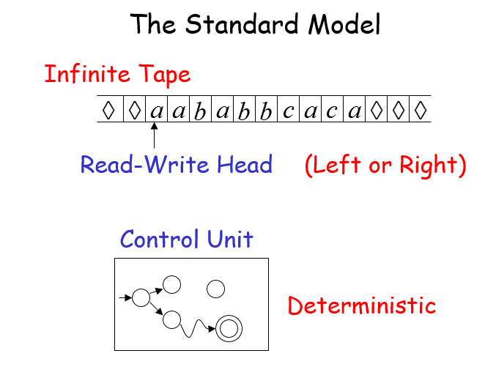
The Standard Model

Slide 5
Variations of the Standard Model
Turing machines with:
Stay-Option
Semi-Infinite Tape
Off-Line
Multitape
Multidimensional
Nondeterministic

Slide 6
Variations of the Standard Model
The variations form different Turing Machine Classes
We want to prove:
Each Class has the same power with the Standard Model

Slide 7
Power of Classes
Same Power of two classes means:
Both classes of Turing machines accept the same languages

Slide 8
Power of Classes
Same Power of two classes means:
For any machine of first class
there is a machine of second class
such that:
And vice-versa

Slide 9
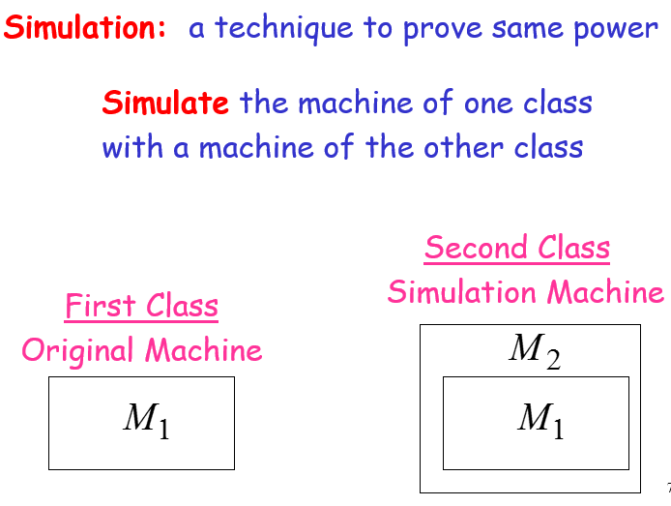
Simulation

Slide 10
Simulation
Configurations in the Original Machine correspond to configurations in the Simulation Machine
Original Machine:
Simulation Machine:

Slide 11
Simulation
Final Configuration
Original Machine:
Simulation Machine:
The Simulation Machine and the Original Machine accept the same language

Slide 12
Turing Machines with Stay-Option
The head can stay in the same position
Left, Right, Stay
L,R,S: moves

Slide 13
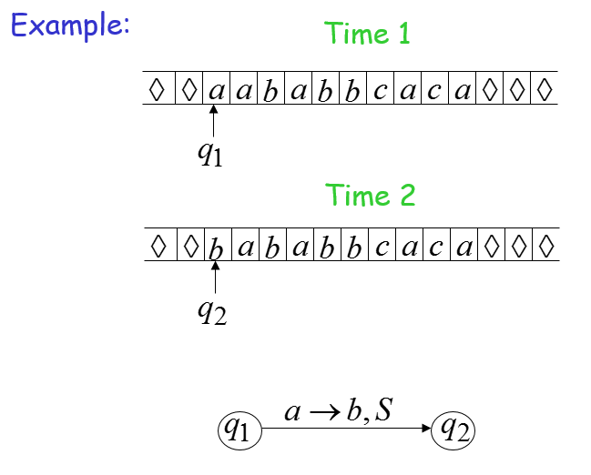
Turing Machines with Stay-Option

Slide 14
Turing Machines with Stay-Option
Theorem:
Stay-Option Machines have the same power with Standard Turing machines

Slide 15
Turing Machines with Stay-Option
Proof:
Part 1: Stay-Option Machines are at least as powerful as Standard machines
Proof:
a Standard machine is also a Stay-Option machine (that never uses the S move)

Slide 16
Turing Machines with Stay-Option
Proof:
Part 2: Standard Machines are at least as powerful as Stay-Option machines
a standard machine can simulate a Stay-Option machine
Proof:

Slide 17
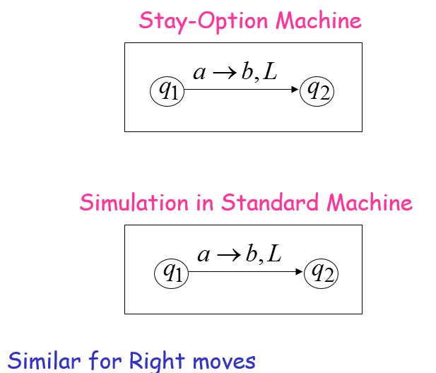
Turing Machines with Stay-Option

Slide 18
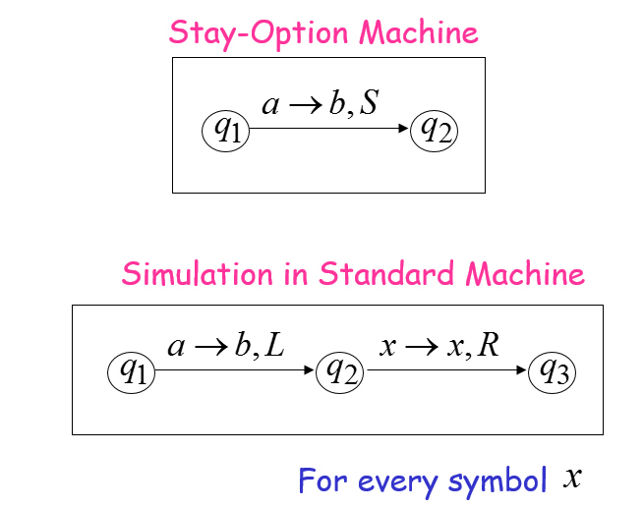
Turing Machines with Stay-Option

Slide 19
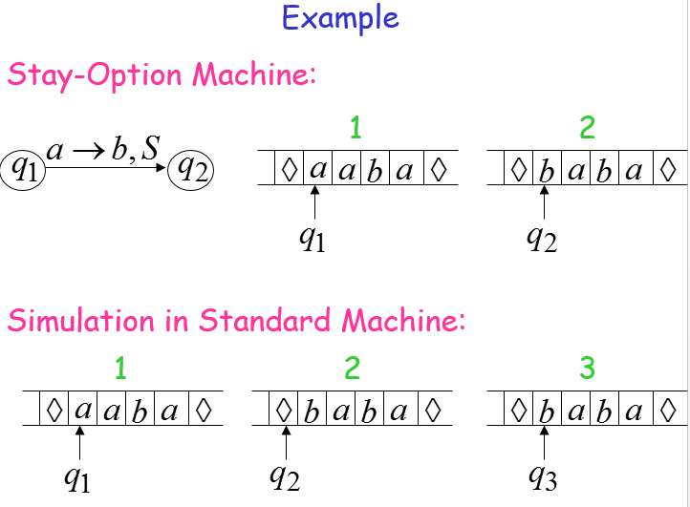
Turing Machines with Stay-Option

Slide 20
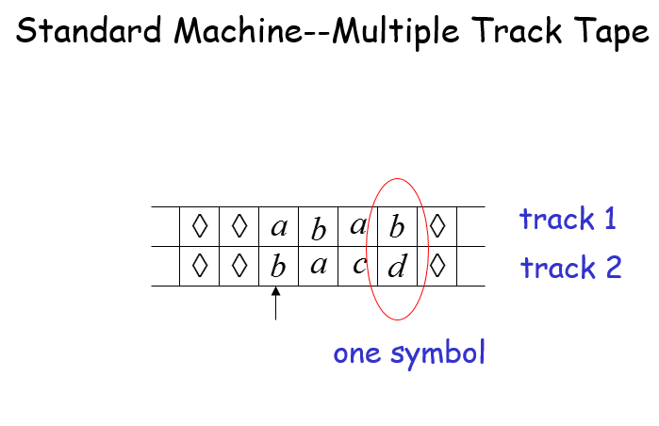
Standard Machine--Multiple Track Tape

Slide 21
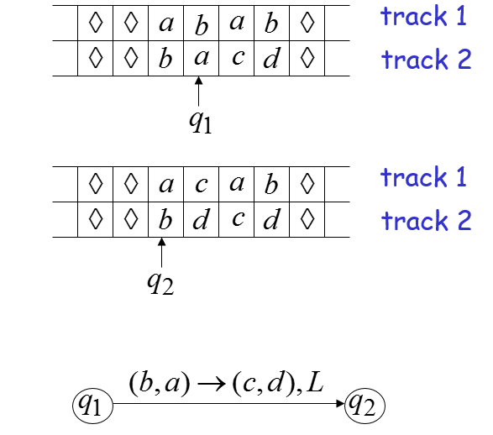
Standard Machine--Multiple Track Tape

Slide 22
Semi-Infinite Tape
.........

Slide 23
Semi-Infinite Tape
Standard Turing machines simulate Semi-infinite tape machines:
Trivial

Slide 24
Semi-Infinite Tape
Semi-infinite tape machines simulate Standard Turing machines:
Standard machine
.........
.........
Semi-infinite tape machine
.........

Slide 25
Semi-Infinite Tape
.........
.........
Standard machine
reference point
Semi-infinite tape machine with two tracks
Right part
.........
Left part

Slide 26
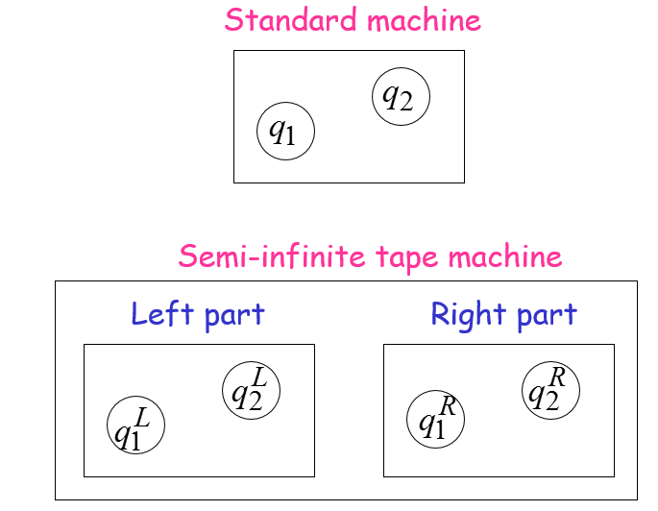
Semi-Infinite Tape

Slide 27
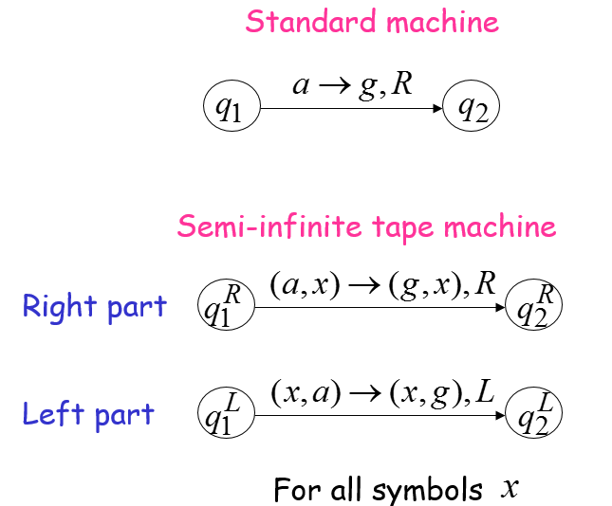
Semi-Infinite Tape

Slide 28
Time 1
.........
.........
Standard machine
Semi-infinite tape machine
Right part
.........
Left part

Slide 29
Time 2
.........
.........
Standard machine
Semi-infinite tape machine
Right part
.........
Left part

Slide 30
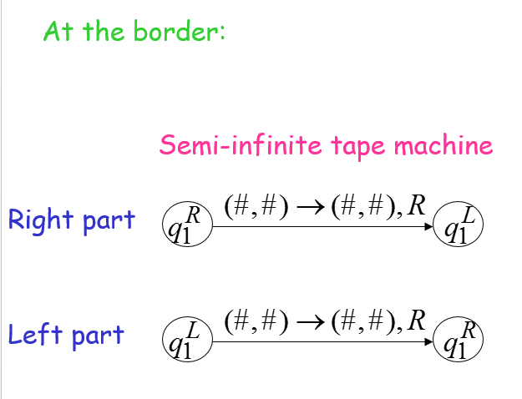
Semi-Infinite Tape

Slide 31
Semi-Infinite Tape Machine
Time 1
Right part
.........
Left part
Time 2
Right part
.........
Left part

Slide 32
Theorem
Semi-infinite tape machines have the same power with Standard Turing machines

Slide 33
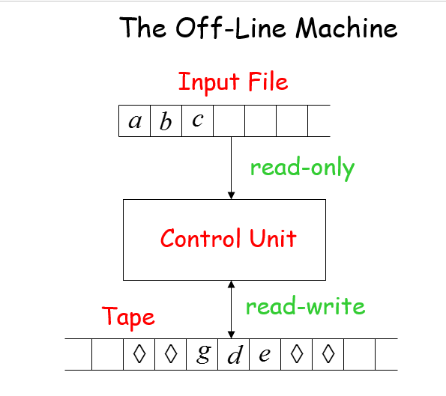
The Off-Line Machine

Slide 34
The Off-Line Machine
Off-line machines simulate Standard Turing Machines:
Off-line machine:
1. Copy input file to tape
2. Continue computation as in Standard Turing machine

Slide 35
Standard Machine
Off-line machine
Input File
Tape
1. Copy input file to tape

Slide 36
Standard Machine
Off-line machine
Input File
Tape
2. Do computations as in Turing machine

Slide 37
Standard Machine
Standard Turing machines simulate Off-line machines:
Use a Standard machine with four track tape to keep track of the Off-line input file and tape contents

Slide 38
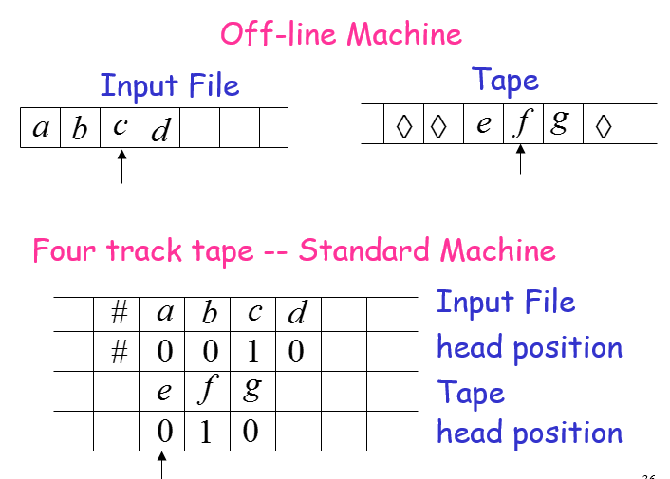
Off-line Machine

Slide 39
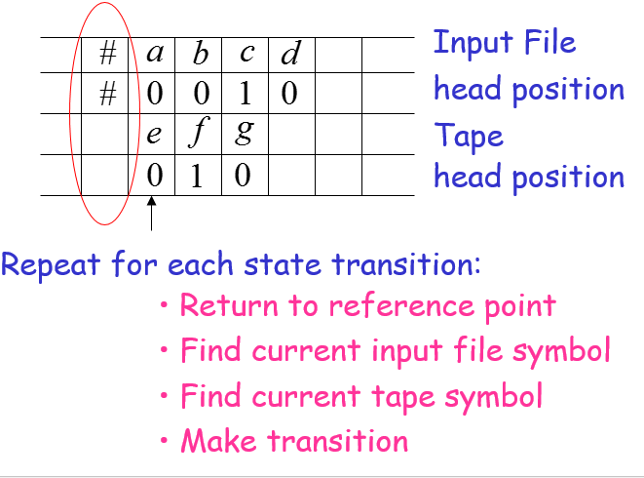
Reference Point

Slide 40
Summary
Each Class has the same power with the standard model
Same power of two classes means both the classes of turing machines accept the same languages
The simulation machine and the original machine accept the same language
Stay-option machines have the same power with standard turing machines

Slide 41
Summary
Standard Turing machines simulate Semi-infinite tape machines
Semi-infinite tape machines have the same power with Standard Turing machines

